Slide 1

Olney Home For Life
A “Village” to assist seniors to age in their home and community

Slide 2
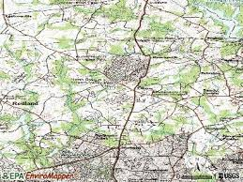
Community We Serve
Services to the elderly in Olney, Sandy Spring, Ashton and Brookeville
Home for 3966 seniors (2012 census data), of which 6.5% are below the federal poverty level
Over 15% of Sandy Spring’s seniors are below the poverty level, the 2nd highest zip code in the county
Partnership with MedStar Cancer Center to support the special transportation needs of their senior patients, even outside our area
Growing number of assisted living facilities

Slide 3
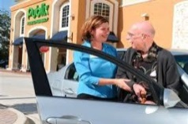


Current Senior Services
Transportation- Provides free transportation to seniors in our area to meet their basic and social needs. In calendar year 2014 provided approximately 1300 rides of which over 90% were medically related. We support over 15 volunteers that provide rides, with 80 to 100 seniors using the service
Reassurance check-in calling- Provides a daily call, by trained volunteers, to connect and provide a community connection to seniors otherwise alone.
Friendly visiting- In partnership with MC Mental Health Association this pilot service provides visits to seniors for friendship and socialization by specially trained volunteers

Slide 4
The Village Model
?

Slide 5
The Leverage Model
OHFL
Primary Need Provider
Aggregator
Clients / Volunteers

Slide 6
For More Information Please Contact
Tom Brunetto
Chairman
240-463-9928
tombrunetto@yahoo.com
Thank You

